Slide 1
Temperature Based Fan Speed Control Using Arduino
Major Project
Godina Ganga Yaswanth Kumar , 2nd B.Tech(ECE)
Mohan Babu University

Slide 2
INTRODUCTION
In our project, "Temperature Based Fan Speed Control Using Arduino," we'll harness the power of an Arduino microcontroller to create a smart fan system. This project utilizes the processing power of an Arduino to read data from a temperature sensor. Based on this data and pre-programmed settings, the Arduino dynamically adjusts the fan speed. As the temperature climbs, the Arduino instructs the fan to ramp up, providing a refreshing breeze when it's hot and a quieter operation at cooler temperatures. This not only enhances comfort but also promotes energy efficiency by running the fan only as much as needed. With its relative ease of construction and the power of Arduino, this project allows you to build a smart fan system that automatically adapts to your environment.

Slide 3
AIM
The aim of this project is to design and implement a temperature-based fan speed control system using an Arduino microcontroller. The system will automatically adjust the fan speed in response to changes in ambient temperature, ensuring efficient cooling and energy conservation. This project seeks to provide a practical and intelligent solution for temperature regulation in various environments, including electronic devices, residential spaces, and industrial applications.

Slide 4
Apparatus Required:
Arduino Uno board
Breadboard
DC Motor
L293D Motor Driver IC
LM35 Temperature Sensor
9V Battery with a connector
Jumper Wires

Slide 5
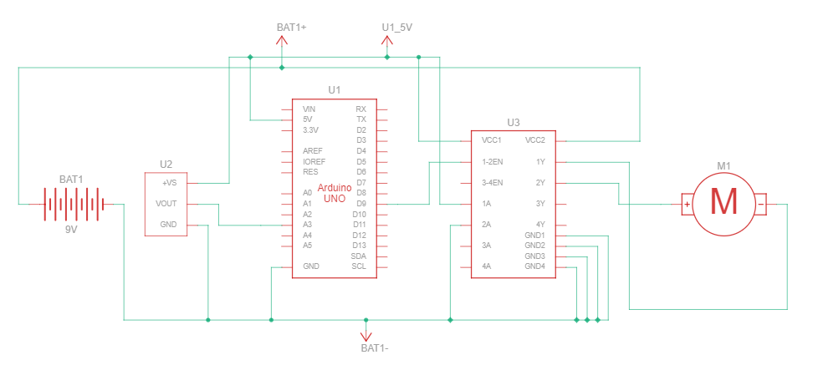
Schematic Sketch
Schematic View
Schematic View

Slide 6
Procedure:
Gather your components: Arduino Uno, breadboard, jumper wires, L293D motor driver IC, potentiometer, DC motor, 9V battery, and a temperature sensor (not shown in the image).
Connect the Arduino Uno to the breadboard.
Connect the L293D motor driver IC to the Arduino Uno. Refer to the specific pin connections in the L293D datasheet for your model.
Connect the potentiometer to the Arduino Uno. A common connection method involves connecting the outer pins of the potentiometer to the Arduino's 5V and GND pins, and the middle pin to an analog input pin of the Arduino (e.g., A0).
Connect the DC motor to the L293D motor driver IC. The L293D will allow you to control the direction and speed of the motor using the Arduino.

Slide 7
Connect the positive terminal of the 9V battery to the Vin pin of the Arduino Uno. Connect the negative terminal of the battery to the GND pin of the Arduino Uno.
Connect the temperature sensor to the Arduino Uno. Refer to the datasheet of your specific temperature sensor for proper connection instructions. It typically involves connecting the sensor's power (VCC) and ground (GND) pins to the Arduino's corresponding pins. The data pin of the temperature sensor goes to a digital pin on the Arduino.
Upload the Arduino code that reads the temperature sensor data, compares it to pre-defined thresholds, and generates a PWM (Pulse Width Modulation) signal to control the motor speed through the L293D motor driver IC. The code should account for the direction of the motor based on temperature changes (optional).
Test and calibrate the system. Power on the system and observe its behavior. You might need to adjust the code's thresholds for desired motor speed changes at specific temperatures.

Slide 8
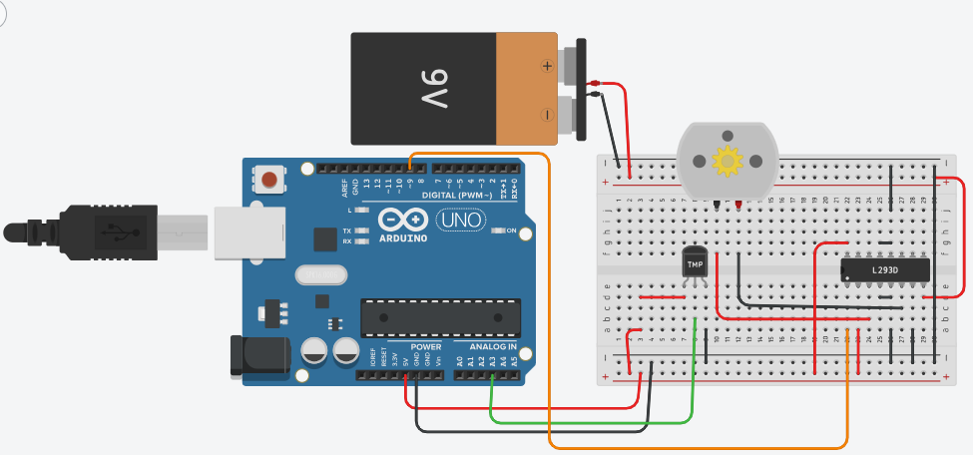
Circuit Connections

Slide 9
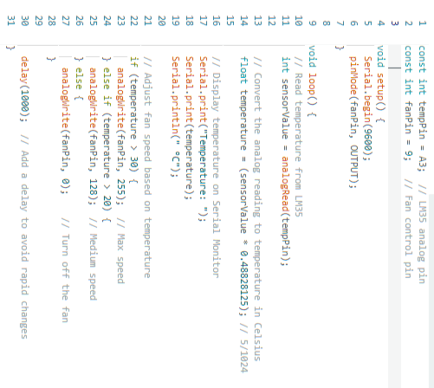
Arduino Code

Slide 10
Working:
Reading Temperature:
The temperature sensor measures the ambient temperature and outputs an analog voltage proportional to the temperature.
The Arduino reads this analog voltage through the analog input pin (A0) using the analogRead() function.
Converting Analog Value to Temperature:
The analog value read from the sensor is converted to a temperature value (in degrees Celsius) using a conversion formula. For the TMP36 sensor, the formula is:
Temperature = ((analog value*5.0/1024) - 0.5) * 100

Slide 11
Mapping Temperature to Fan Speed:
The temperature value is mapped to a PWM value (0 to 255) using the map() function. The PWM value determines the speed of the fan.
The map() function linearly maps the temperature range (e.g., 20°C to 50°C) to the PWM range.
Controlling Fan Speed:
The Arduino outputs a PWM signal to the motor driver's ENA pin to control the speed of the fan.
The IN1 and IN2 pins of the motor driver determine the direction of the fan. For this setup, they are set to spin the fan in one direction.
Motor Driver Operation:
The L293D motor driver receives control signals from the Arduino and powers the fan using the external 9V battery.
The fan speed varies according to the PWM signal sent to the ENA pin.

Slide 12
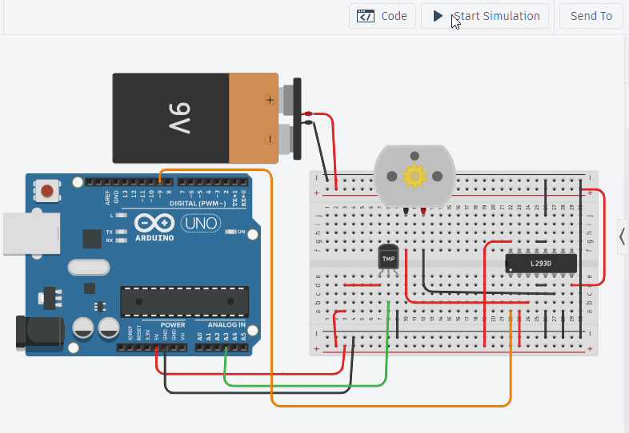
Simulation Video:

Slide 13
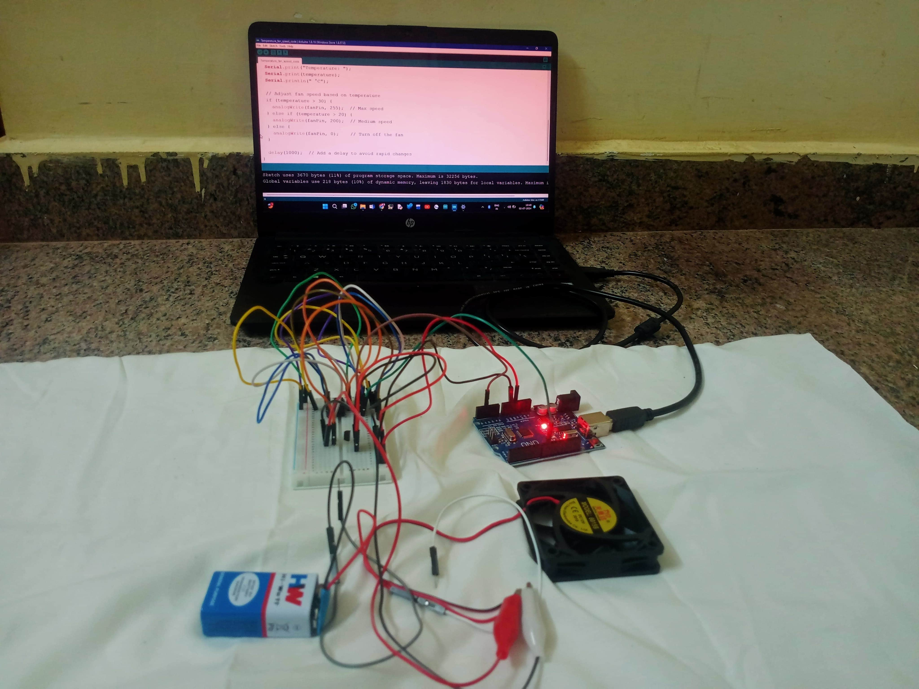
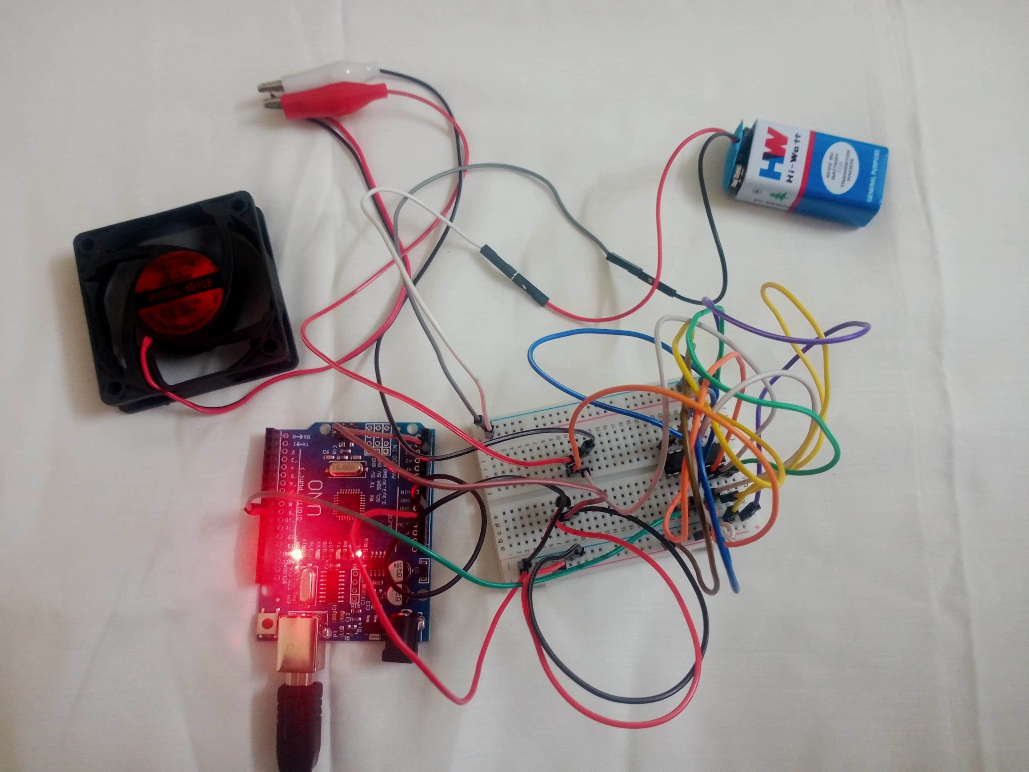
Circuit Images:

Slide 14

Circuit Working Video:

Slide 15
Important URL's:
Thinkercad File :- This link will take you to the Circuit diagram where you can see the circuit, Arduino code of the project and simulate it in thinkercad website.
Thinkercad :- This link will take you to the thinkercad website. SignUp/Login to create your circuits or designs and simulate them for free.
Youtube Video :- This is the link for the youtube video of Temperature Based Fan Speed Control Using Arduino

Slide 16


